Slide 1

Layout
The float Attribute
Two Column Design
Liquid vs Frozen
CSS Table Display

Slide 2

See Also
https://www.w3schools.com/css/css3_flexbox.asp
https://www.youtube.com/watch?v=IiJzbXzOdHQ

Slide 3
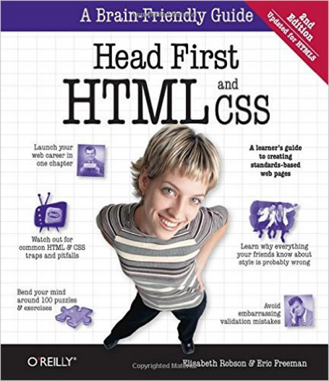
In the Book
Chapter 11:
Layout and Positioning

Slide 4
The Ruler 2.0
Redesign The Rusty Ruler site with a modern layout.
Add a header and footer.
Move the weekly-specials to the main page.
Stylish header
Main Content
Flyer
Expands
Fixed Width
Stylish footer

Slide 5
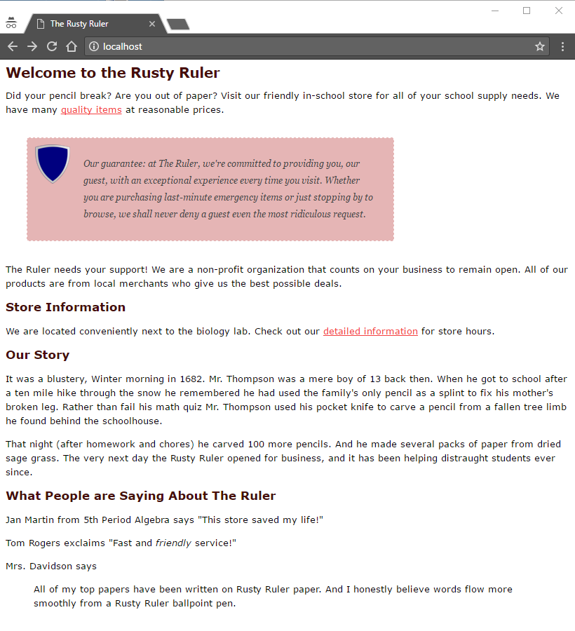
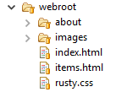
Current Look
Additional text

Slide 6

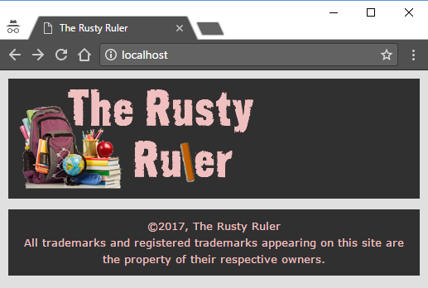
Header and Footer
rusty.css
body {
...
background-color:#E0E0E0;
}
#rustyHeader {
background-color:#303030;
padding:10px;
}
#rustyFooter {
background-color:#303030;
text-align: center;
padding: 10px;
}
#rustyFooter p {
margin: 0px;
color: #F0C0C0;
}
index.html
<body>
<div id="rustyHeader">
<img src="images/store2.png">
</div>
<p>...</p>
<div id="rustyFooter">
<p>&copy;2017, The Rusty Ruler<br>
All trademarks ...</p>
</div>
</body>

Slide 7
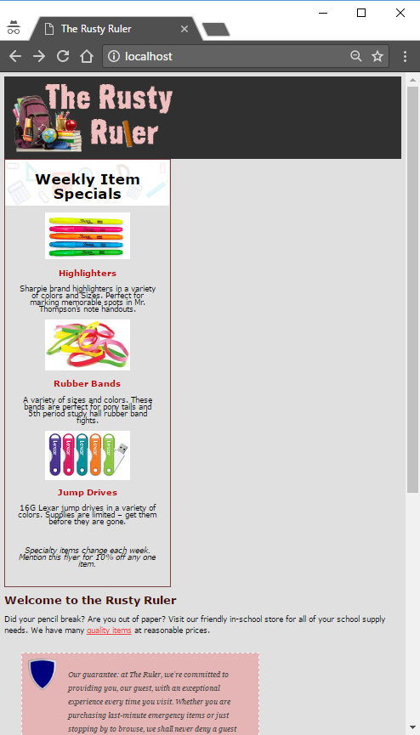
Moving the Flyer
index.html
<html>
<head>
<title>The Rusty Ruler</title>
<link type="text/css" rel="stylesheet" href="rusty.css">
</head>
<body>
<div class="header">
<img src="images/store2.png">
</div>
<div id="flyer">
<div class="header">
<h2>Weekly Item Specials</h2>
</div>
...
<div class="footer">
<p>Mention this flyer ...</p>
</div>
</div>
<h1>Welcome to the Rusty Ruler</h1>
items.html

Slide 8
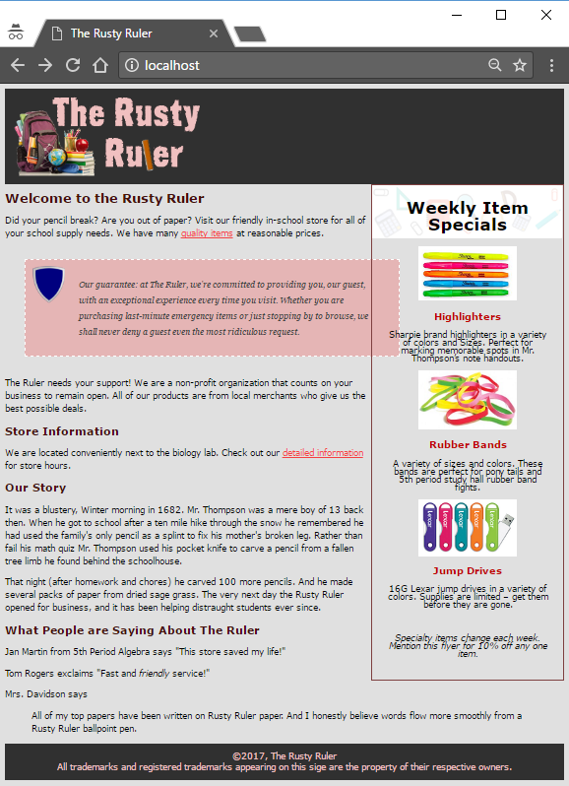
Floating the Flyer
Spacing
rusty.css
#flyer {
border-width: thin;
border-style: solid;
border-color: #7e4040;
width: 250px;
float: right;
padding-right: 20px;
padding-bottom: 20px;
padding-left: 20px;
text-align:center;
background-image: url(images/sale.png);
background-repeat: no-repeat;
line-height: 1;
}
Needs to be white

Slide 9
Floating Above Blocks
The browser flows the page top to bottom.
A floating element starts where it would normally be down the page.
Block elements take up the width of the page as normal. They extend under the floating element.
Inline elements wrap around the floating elements.
Extends behind the float
Inline elements wrap around the float.
Beyond the float the
inline elements fill the block.

Slide 10
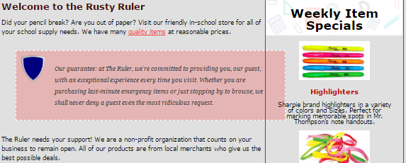
Floating Above Blocks
<p> 250px margin

Slide 11
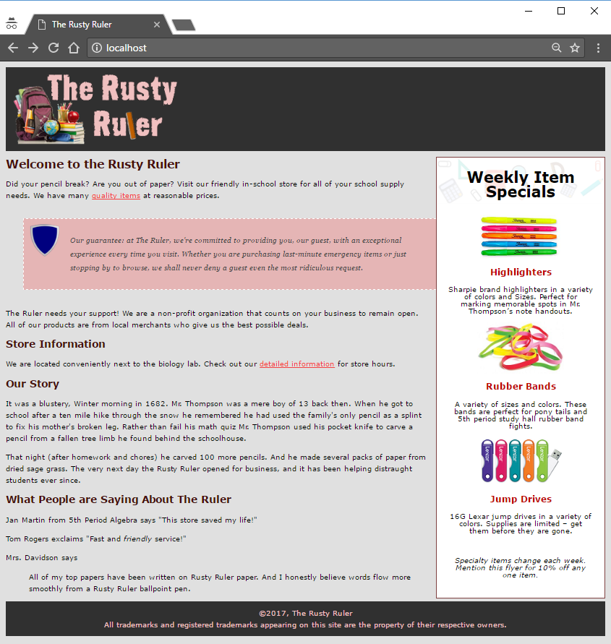
Color and Spacing
Not an easy fix for this. Let’s remove the border and color for now.
#flyer {
border-width: thin;
border-style: solid;
border-color: #7e4040;
width: 250px;
float: right;
margin: 10px 0px 10px 10px;
padding-right: 20px;
padding-bottom: 20px;
padding-left: 20px;
text-align:center;
background-color: white;
background-image: url(images/sale.png);
background-repeat: no-repeat;
line-height: 1;
}

Slide 12
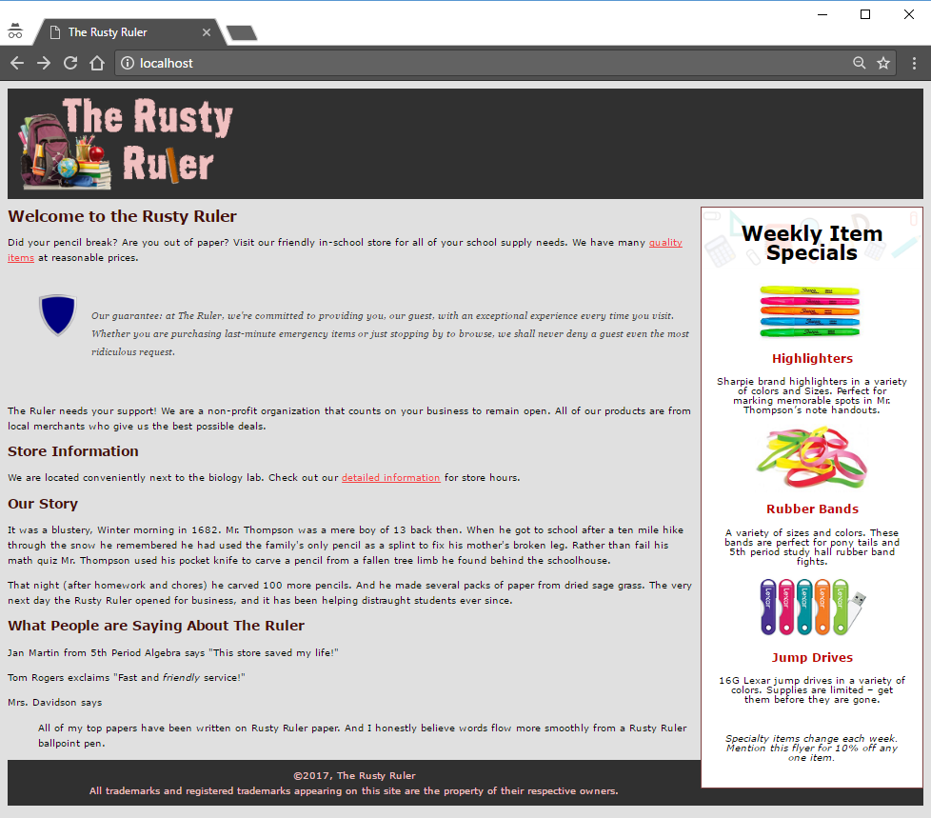
Test the Resize
Test your page to see how it looks in different window shapes.
This is a common problem with an easy fix.

Slide 13
All Clear
Inline elements wrap around the float.
Has the clear: right property
The browser moves the element down the page until it is clear of floaters (on the right)
Beyond the float the
inline elements fill the block.

Slide 14
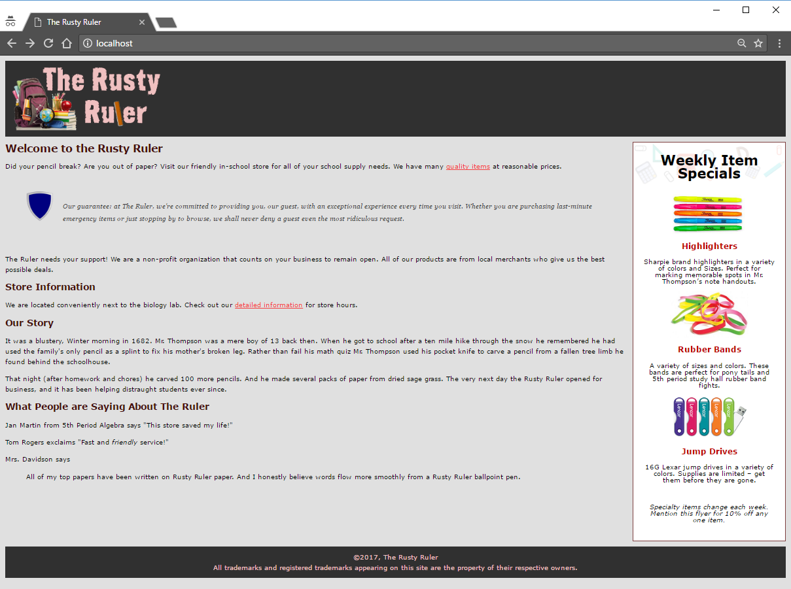
All Clear
#rustyFooter {
background-color:#303030;
text-align: center;
padding: 10px;
clear: right;
}

Slide 15
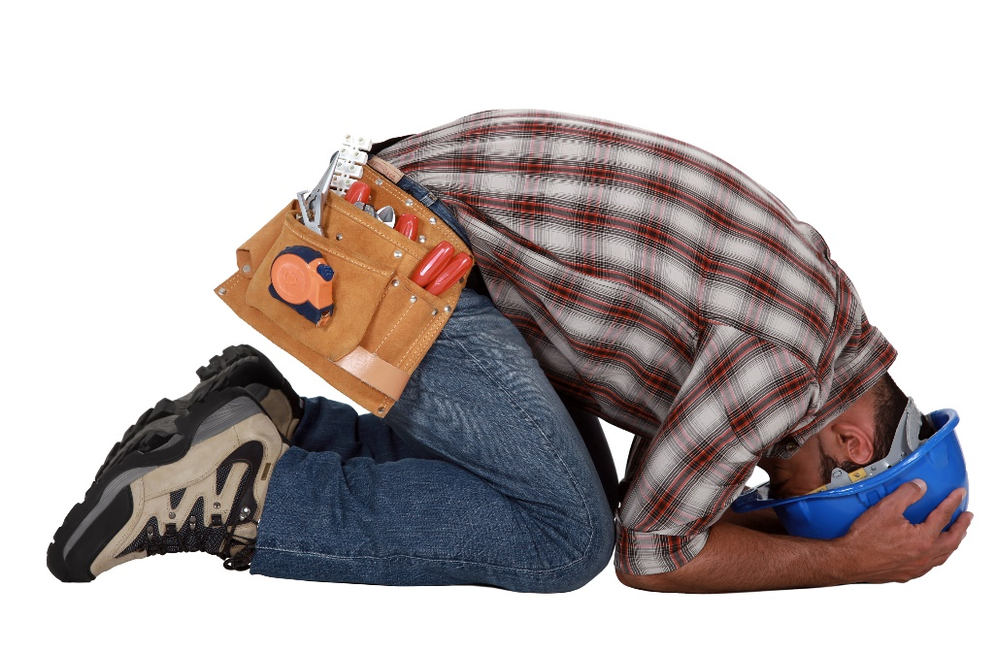
Layout is an Art
The simple two-column layout proved tricky.
We still didn’t solve the “guarantee” border and color.
Lots of trial and error in implementing it.
Your design might look perfect … until you resize the browser.

Slide 16
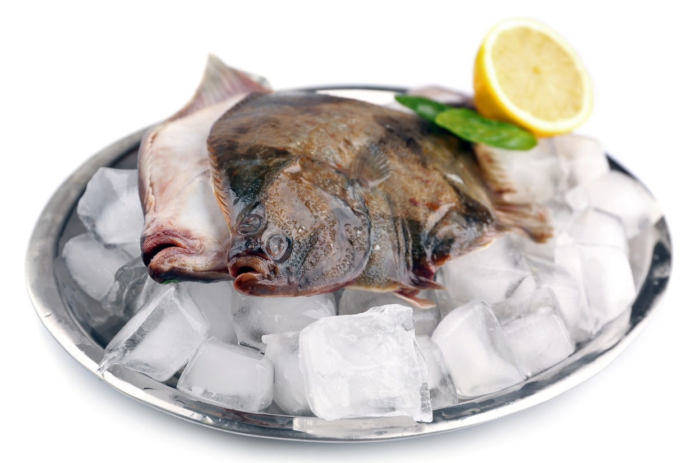
Liquid and Frozen Layouts
A page that resizes with the browser: LIQUID
A page with fixed content size: FROZEN
We just built a liquid page.
Now for a frozen one.

Slide 17
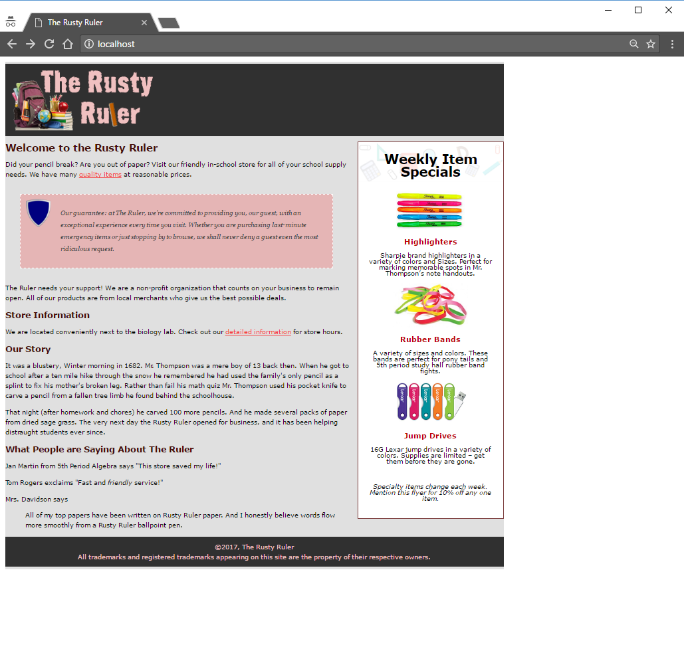
The Frozen Ruler
index.html
<body>
<div id="allcontent">
<div id="rustyHeader"> ... </div>
...
<div id="rustyFooter"> ... </div>
</div>
</body>
rusty.css
body {
...
background-color: #E0E0E0;
}
#allcontent {
width: 1000px;
padding-top: 5px;
padding-bottom: 5px;
background-color: #E0E0E0;
}
#guarantee {
width: 520px;
...
}
1000px

Slide 18
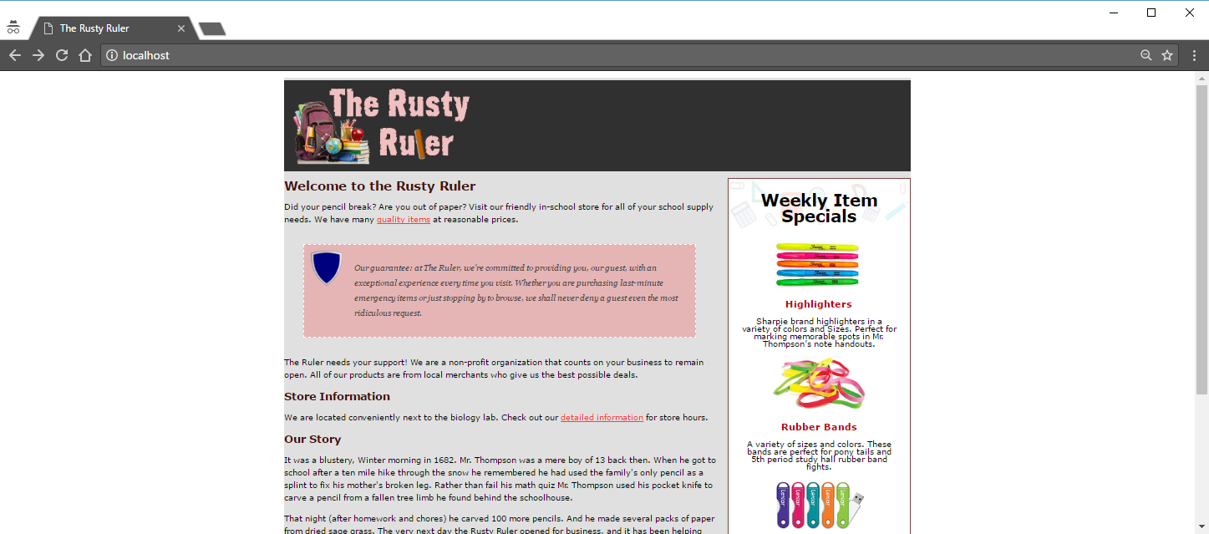
Auto Margins
#allcontent {
...
margin-left: auto;
margin-right: auto;
}

Slide 19
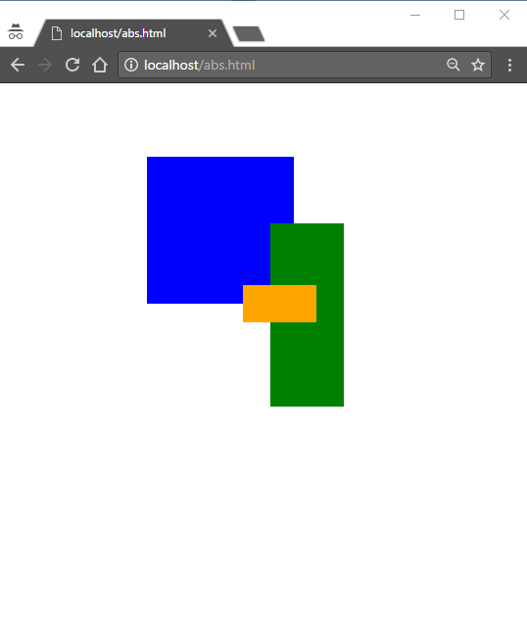
Absolute Positioning
<body>
<div id="boxA"></div>
<div id="boxB"></div>
<div id="boxC"></div>
</body>
100
#boxA {
position: absolute;
top: 100px;
left: 200px;
width: 200px;
height: 200px;
background-color: blue;
}
#boxB {
position: absolute;
right: 250px;
bottom: 300px;
width: 100px;
height: 250px;
background-color: green;
}
200
275
330
250
#boxC {
position: absolute;
top: 275px;
left: 330px;
width: 100px;
height: 50px;
background-color: orange;
z-index: -2;
}
300

Slide 20
Table Display
Column
Row
Cell
header
Table
<body>
<div id="rustyHeader"> ... </div>
<div id="tableContainer">
<div id="tableRow">
<div id="main"> ... </div>
<div id="flyer"> ... </div>
</div>
</div>
<div class="footer"> ... </div>
</body>
main
flyer
1 Row
footer

Slide 21
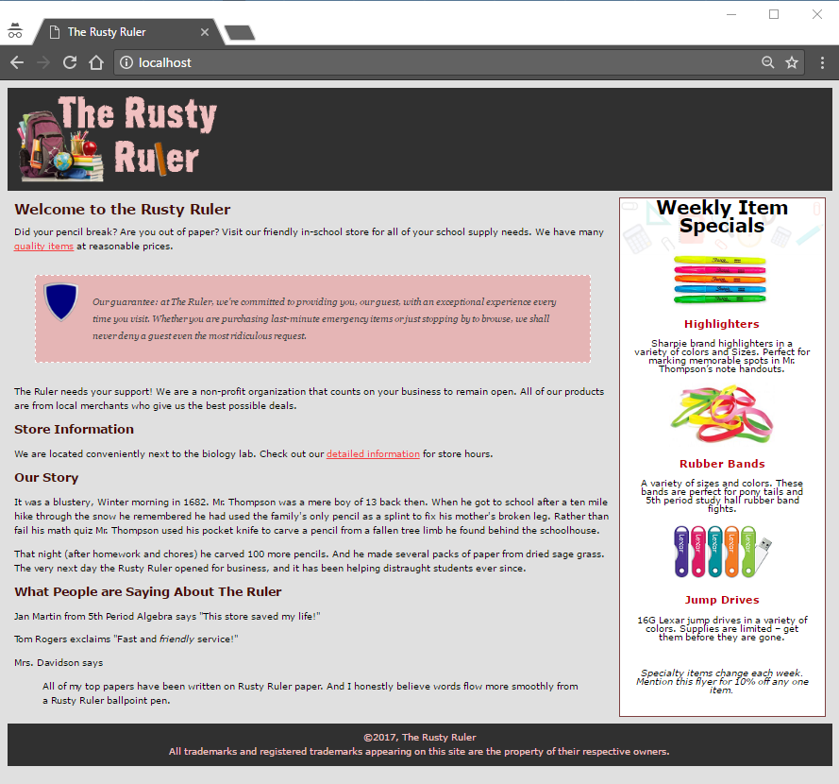
Table Display
#tableContainer {
display:table;
border-spacing: 10px;
}
#tableRow {
display:table-row;
}
#flyer {
display: table-cell;
...
}
#main {
display: table-cell;
}

Slide 22
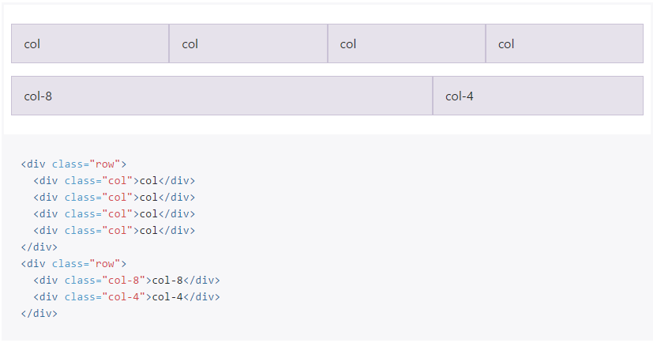
Other Options: Bootstrap (twitter)
http://getbootstrap.com/

Slide 23
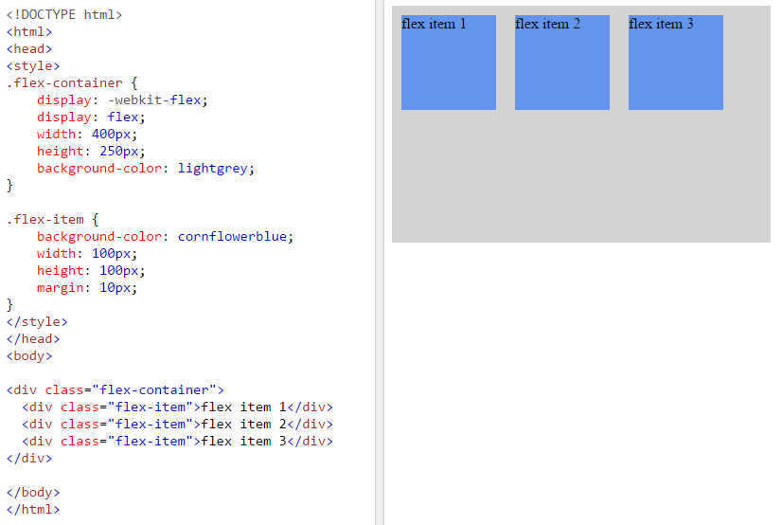
Other Options: CSS3 Flexbox
Fairly new (not supported by less-than IE11).

Slide 24

Tinkering
Add a list of open/closed dates to the “about” page of the Rusty Ruler. Like:
Closed Monday for Memorial Day
Closing early Wednesday for pep rally.
Open all day Friday!
Try floating the list left then right.
Try using a table layout.

